Slide 1
Research Methods in Biomedical Informatics Programming Assignment, Spring 2022
Final presenation
Nourah Salem

Slide 2
TABLE OF CONTENTS
01
02
03
04
Introduction
Solution Approach
What is the problem and its significance
Why we decided out solution algorithm
Methodology
Results and discussion
Steps from input to our target output
Output visualization, discussion

Slide 3
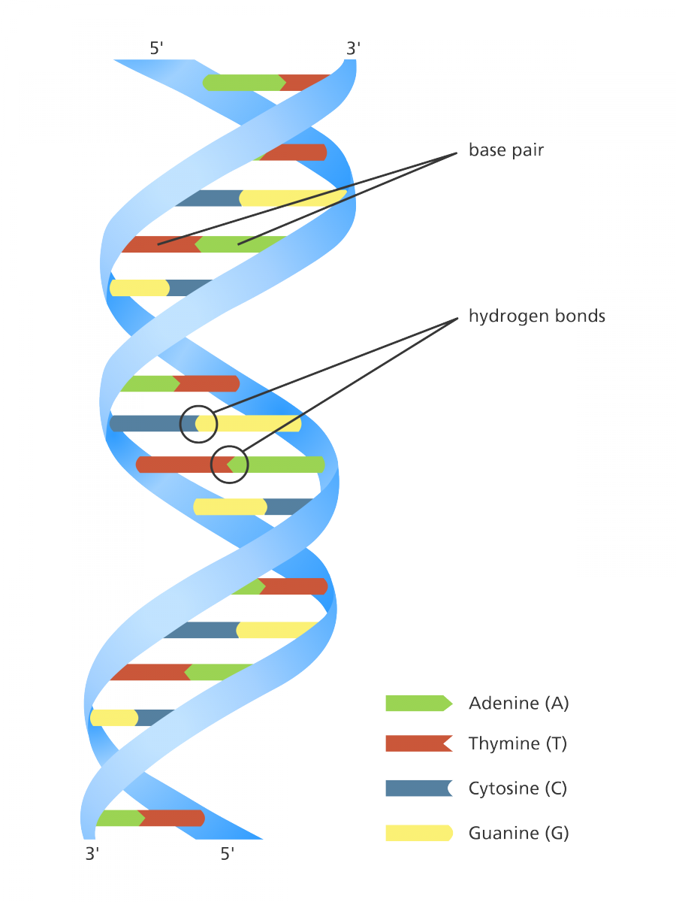

INTRODUCTION
Genetic Material
A,T,C,G
Why study DNA?
Diseases and Treatments
History

Slide 4
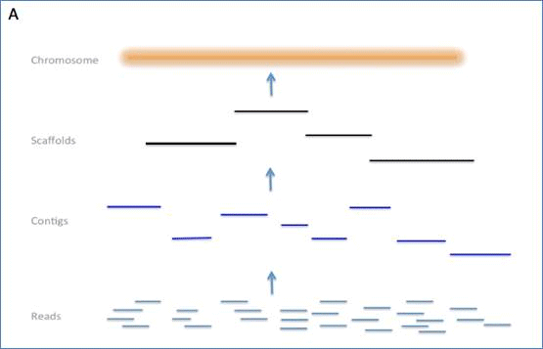
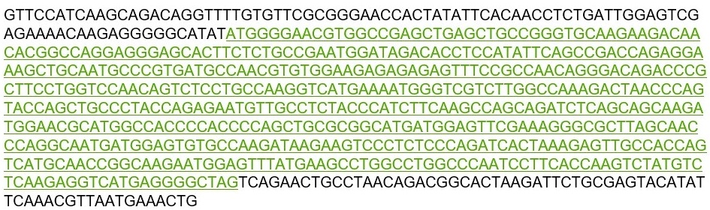
INTRODUCTION

Slide 5
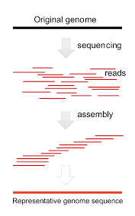
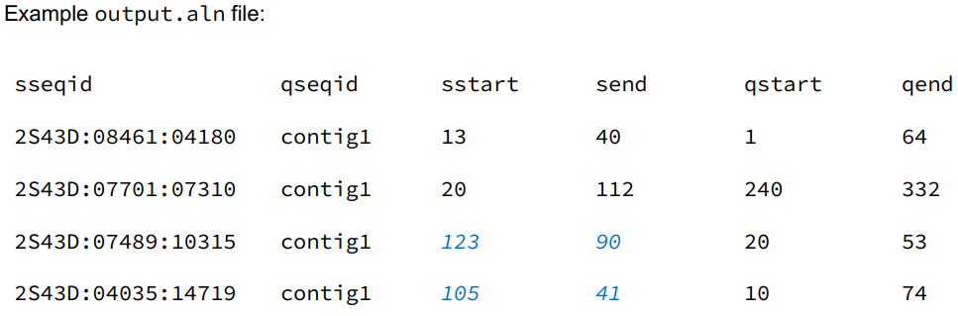
ABOUT the problem
Query

Slide 6
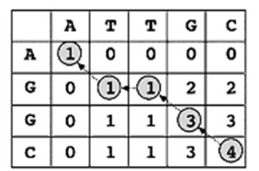
Solution Key
The core proniciple for solving our problem is to COMPARE (parts of) two sequences.

Slide 7
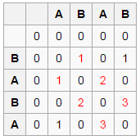
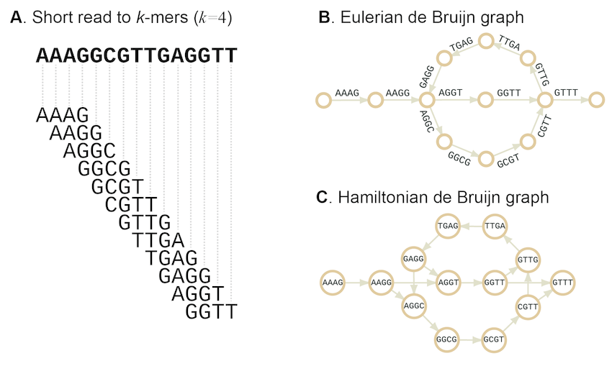
OUR Solution Options
Matrices
Longest Common Substring
Longest Common Substring
Graphs
De Bruijn Graph

Slide 8
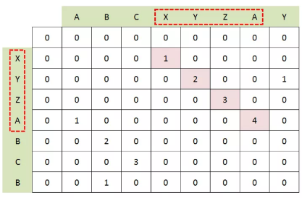
Solution Approach
Inputs:
ABCXVZAY
XYZABCB
https://gabrielghe.github.io/university/2016/01/04/longest-common-subsequence

Slide 9
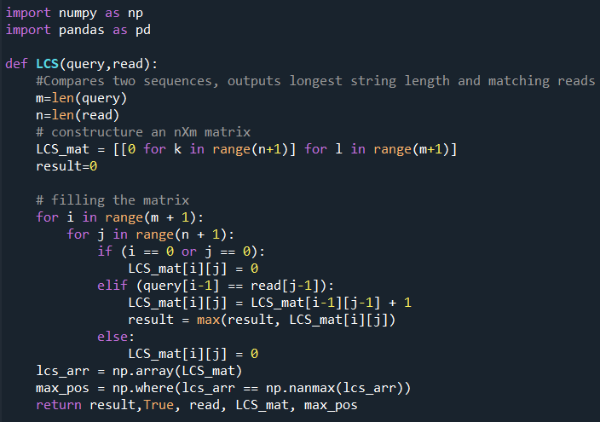
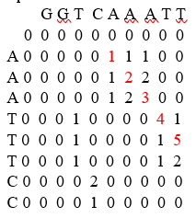
Methodology
Read
Query

Slide 10
Script Run

Slide 11
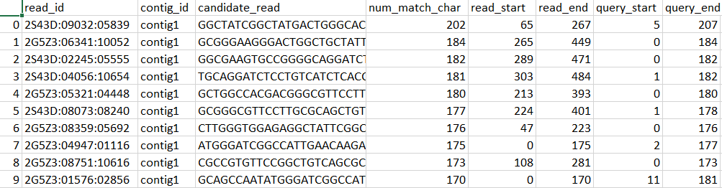
Final Output (from this module)

Slide 12
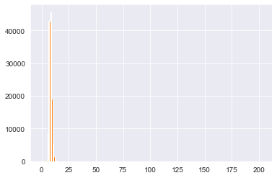
Threshold for the number of matches
Length of Alignment Threshold (bases) | Number of reads per contig | Do they cover the whole query range?
> 13 | 153 | True
> 45 | 127 | True
> 90 | 82 | True
> 130 | 43 | True
> 140 | 24 | False

Slide 13
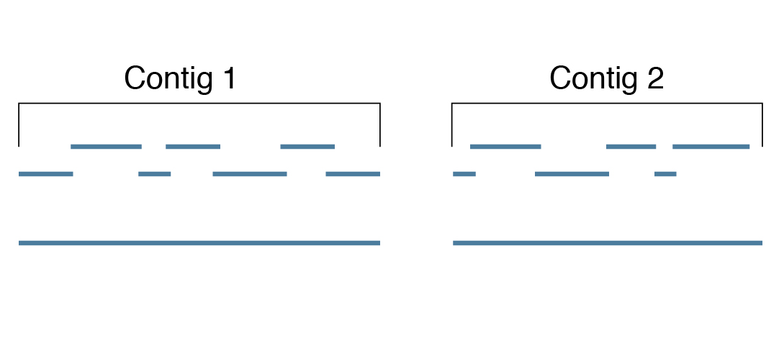
Validation Module
Case
Case

Slide 14
Validation Module
Query
[G G G A T C G G C C A T T G A]
[False, False, False, False, False, False, False, False, False, False, False, False, False, False, False]
Candidate
Reads
1. [True, True, True, False, False, False, False, False, False, False, False, False, False, False, False]
2. [Flase, Flase, Flase, True, True, True, True, True, True, True, True, True, True, False, False, False]
3. [Flase, Flase, Flase, False, False, False, False, False, False, False, False, False, True, True, True]
Output: [True, True, True, True, True, True, True, True, True, True, True, True, True, True, True, True, True]

Slide 15
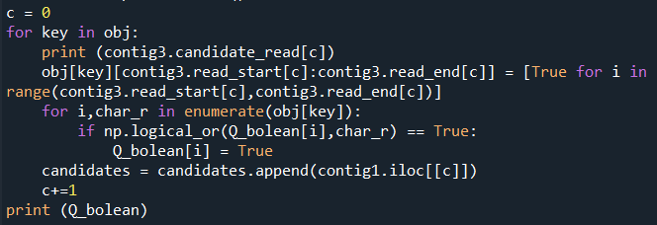
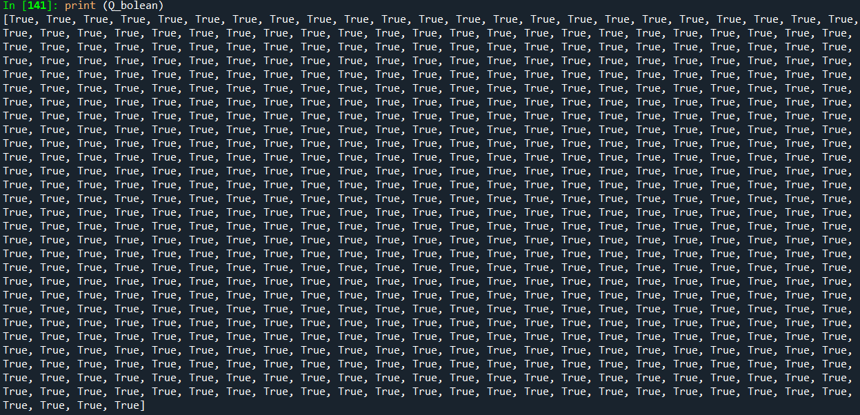
Validation Result!
Query Length: 648 char
Spanned by: ~43 reads
Contig1 Length: 7180 char
Contig2 Length: 7171 char

Slide 16
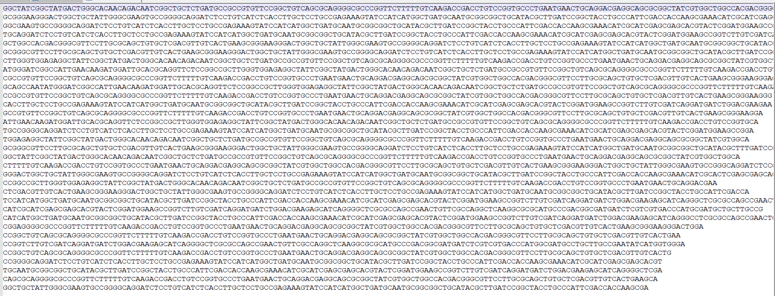
Validation Result!
Contig 1

Slide 17
Thank you!

